Slide 1

CSE 216
DATABASE PROJECT
PRESENTATION
Group : 03
Lab section : B2
PROJECT SUPERVISOR
NAFIS IRTIZA TRIPTO
LECTURER
DEPT of CSE, BUET
PRESENTED BY
FATIMA NAWMI 1705093
NAZMUL TAKBIR 1705103

Slide 2
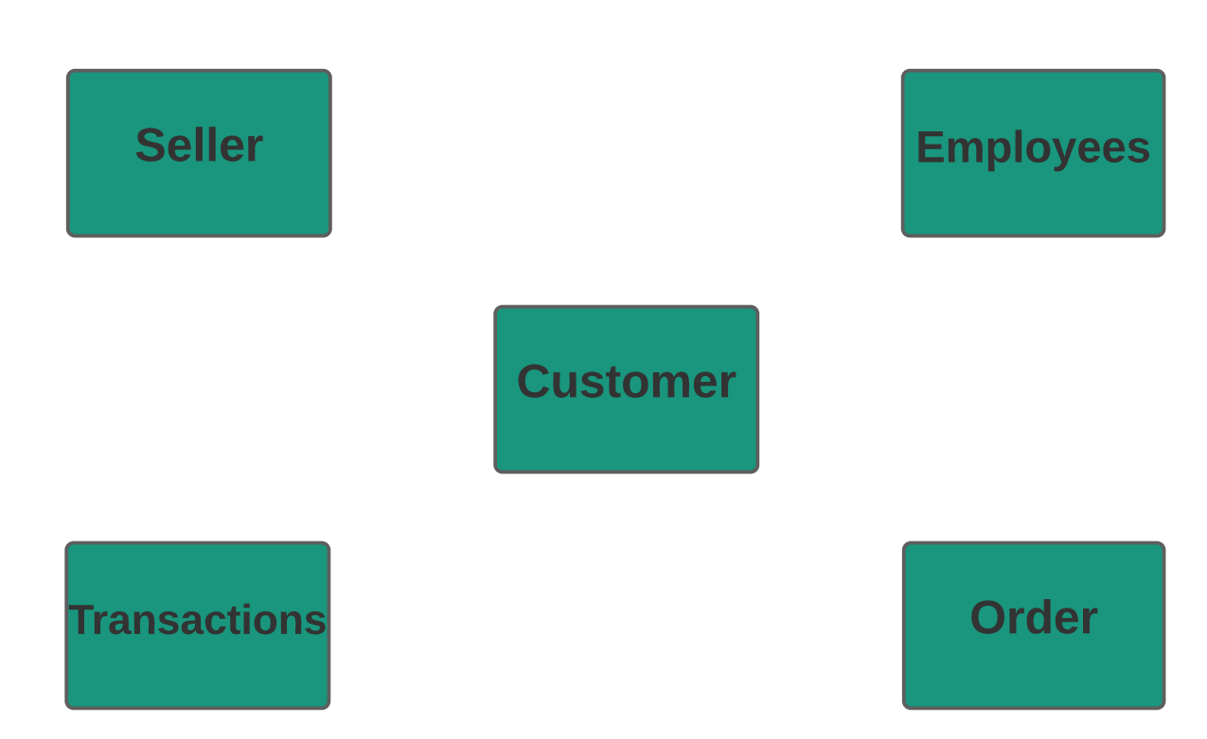
Key Parts of the Project

Slide 3
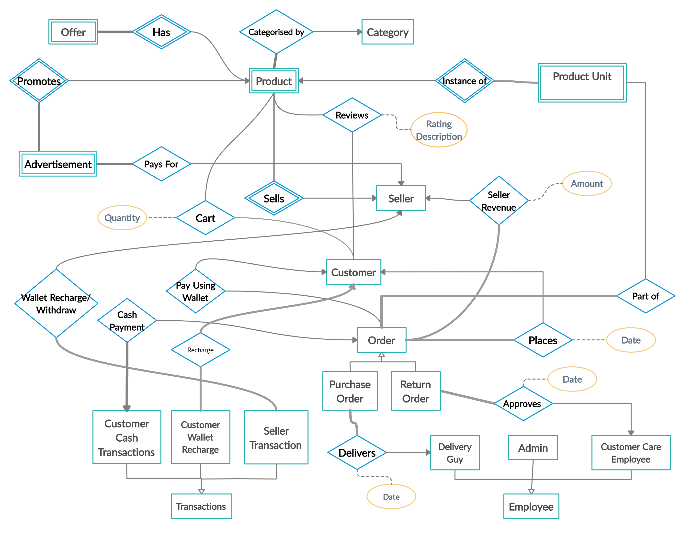

Slide 4
Frameworks and Technologies Used
Database : Oracle
Backend : Django
Frontend : Bootstrap, Javascript with AJAX
cx_Oracle module was used as the Python interface for the Oracle Database
NB: As per the project requirement, we did not make use of the Django ORM, but rather wrote raw SQL queries.

Slide 5
Usage of PL SQL
1 PL SQL stored procedure
6 PL SQL functions
1 Trigger

Slide 6
ADD_ITEM Procedure
When seller adds new product, multiple DML statements make insertions in different tables Product Table Product Features Table Product Pictures Table
Wrapping all these DML statements inside a PL SQL procedure, using SAVEPOINT and ROLLBACK where needed, makes the entire process atomic

Slide 7
STRING_SIMILARITY Function
Used to produce product search results based on search string from user
Each word of search string is compared with each word of product name and seller name and a similarity score is calculated using Oracle's built-in edit-distance algorithm
Helps us return valid search results even if there was a typo from the end of the user.
Search results are ranked according to the similarity score to show more relevant results at the top

Slide 8
Wallet Balance Function
Given Customer ID or Seller ID returns the wallet balance of that Customer or Seller respectively
For Customer, all Purchase Orders, Return Order and Wallet Recharges are considered.
For Seller, all Purchase Orders, Return Orders, Advertisement Purchases, Wallet Recharges and Wallet Withdrawals are considered.

Slide 9
PRICE_TRIGGER
Problem:
User Orders Item seeing a particular price for a product
Before delivery date, the price was changed by the seller.
At delivery time, the amount payable is inconsistent with what the user was originally shown
Solution:
Each time price of a product is updated by a seller, a Trigger stores the previous price and its date validity range in a PRODUCT_HISTORY table.

Slide 10
ORDER_TOTAL Function
Given ORDER_ID, calculates the total amount payable for that order.
Chooses appropriate price of product according to the order placement date.
Chooses appropriate discount percentage according to the order placement date and quantity ordered.

Slide 11
HAVERSINE Function
Due to time shortage and billing related issues, we could not make use of the Google Maps API.
Instead, we used the HAVERSINE formula to calculate the distance a delivery guy would need to travel to deliver a product – given the locations of the buyer, seller and the delivery guy.
Delivery guy is assigned such that the distance travelled is least.

Slide 12
We used two more PL SQL Functions to make our queries more readable.
AVG_RATING Function
Given the product ID and seller ID returns the average user rating for that product
MAX_DISCOUNT Function
Returns the maximum percentage discount available for a product on a given date

Slide 13
Thank You!

